Slide 1
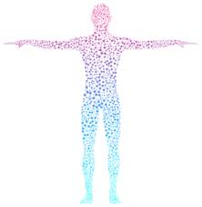
Interoception
Loulette Schieke
Occupational Therapist

Slide 2
What is interoception?
Provides information about the internal condition of our body—how our body is feeling on the inside.
One of our 8 senses
https://youtu.be/A0zbCiakjaA
Notes:
Interoception is an internal sensory system in which the internal physical and emotional states of the body are noticed, recognised/identified and responded to. Interoception skills are required for a range of basic and more advanced functions such as knowing when to go to the toilet, being aware that you are becoming angry or upset and being able to manage your emotions proactively. When children and young people have not yet developed interoception skills they will struggle with not only their own emotions but with social interactions and even just being around others may be difficult for them to manage.
Can also think of it as ‘mindful body awareness’

Slide 3

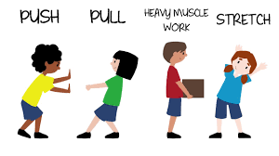
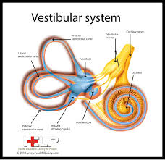
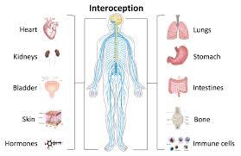
Our 8 senses
Outside senses
Inside senses
Proprioception
Vestibular.
Interoception

Slide 4
Interoception…
Experience body sensations such as growling stomach, dry mouth, tense muscles, racing heart
Awareness off these sensations enables us to experience essential emotions such as hunger, fullness, thirst, pain, body temperature, need for bathroom, sexual arousal, relaxation, anxiety, sadness, frustration and safety
Manage the way we feel – prompting us to take action based on the body signals we notice.
Notes:
At most basic level – allows to answer the question ‘how do I feel’ at eny given moment

Slide 5
Interoception allows us to experience many important feelings:
Body states (basic functions or physical conditions of the body)
Hunger
Thirst
Pain
Sexual arousal
Headache
Temperature
Emotion states (moods ore emotional conditions)
Anger
Embarrassment
Happiness
Anxiety
Excitement
Sadness
Fear

Slide 6
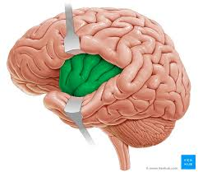
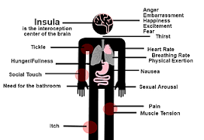
Interoception and the Brain (Insula)
Notes:
Based on substantial research, we now know that the insula (interoceptive center of brain) is significantly impacted in people with ASD.
This includes connectivity within subdivisions of the insula and between the insula and other areas of the brain, activities within the insula as well as structural differences (reduced gray matter volume in insula)
Given that the insula is the interocpetion centre of the brain, this provides a brain-based explanation for the interoceptive difficulties reported by many people with ASD
We need to shift our thinking and approach self-regulation in a different manner – we need to use methods that get at the root of the cause – the underlying skill difficultly.
Without good IA – good self-regulation cannot exist.

Slide 7
Interoception and the autistic brain
Notes:
Self-awareness on the interoceptive level is a pre-requisite for accurate self-awareness of self in terms
of strengths, abilities and support needs in the long term. Research confirms the neurological basis for
many differences inherent in the autistic spectrum (Lovett 2005). Older autistic spectrum young people
may find it helpful to understand the internal processing and response to external stimuli differences
between autistic spectrum brains and non-autistic spectrum brains. An overview of the differences
between autistic spectrum and non-autistic spectrum brains is given below (adapted from Baker-
Ericzen, 2013 and Lovett, 2005).

Slide 8
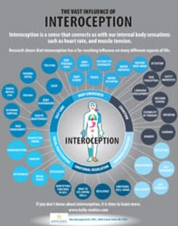
Vast influence of Interoception
Activities of Daily living
Self-awareness
Self-agency
Language development
Reading facial expressions
Theory of mind
Body Ownership
Personal Space
Attunement
Attachment
Resilience
Social Intuition
Resilience
Emotional Regulation
Homeostasis
Peri personal space
Decision making
Intuition and gut feelings
Flexibility of thought
Time perception
Social and pleasant touch
Notes:
Not an exhaustive list
Reseach: Interoception feeds into many of these fields.

Slide 9
Interoception and self-regulation
The ability to IDENTIFY and MANAGE the way you feel
Notes:
When trying to achieve an internal balance, or homeostasis, the behaviours or actions are all a form of self-regulation. Simply – self regulation is our ability to control the way we feel and act.
Closely tied to our interoception curriculum
Interoceptive signals alert us that our internal balance is off and motivate us to take action – to do something that will restore the internal balance. Thus – the Interoception system drive our self-regulation behaviours.
This vital ability to sensory our interceptive signals is referred to as interoceptive awareness.

Slide 10

Interoception as our body’s emotion gauge
Notes:
You rely on your car’s gasoline gauge to let you know the current gas level in your car
Based on this – you know exactly what action is you need to take – if it is close to full – you can keep going without worry, if in middle, you can keep going, but should make a plan to stop for gas sometimes in the next 100 miles. If empty – you need to take action to fill the tank.
Imagine this gauge stopped working. Without clear, specific information it would be challenging to discern the exact level of gas in your tank.

Slide 11
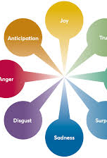
Self-regulation of AFFECTIVE EMOTIONS
Happiness
Anxiety
Frustration
Boredom
Shame
Fear
Notes:
All day, everyday
Our affective emotions – our usual emotions

Slide 12
Self-regulation of Homeostatic emotions
Hunger
Fullness
Thirst
Need for bathroom
Pain
Illness
Body temperature
Sexual arousal
Sleepiness
Exertion
Fever
Physical attraction
Constipation
Sensory overwhelm
Notes:
Also expected to regulate our ‘Homeostatic emotions’

Slide 13
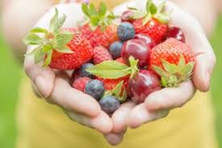
Hunger regulation
(This is interoceptive awareness)
Notice body signals
(Growling stomach, heavy muscles, sluggishness)
CONNECT the body signals to emotion
(Hungry)
URGE TO ACT
REGULATE with an action
(Eat)
Outcome
(Discomfort fades – no more growling and tingly stomach, heavy muscles )

Slide 14

Health regulation
(This is interoceptive awareness)
Notice body signals
(Achy muscles, overall chill, sore throat)
CONNECT the body signals to emotion
(Sick)
URGE TO ACT
REGULATE with an action
(Tell a parent, get medicine or further medical care)
Outcome
(Discomfort fades – no more achy muscles, overall chill, sore throat)

Slide 15

Anxiety Regulation
(This is interoceptive awareness)
Notice body signals
(Shaky hands, fast heart, swirling brain and shut off ears)
CONNECT the body signals to emotion
(Anxious)
URGE TO ACT
REGULATE with an action
(Go for a walk)
Outcome
(Discomfort fades – no more shaky hands, fast heart, swirling brain, shut off ears)

Slide 16
IA and Self Regulation
Body
Emotion
Action
Dry mouth and throat
Thirsty
Drink
Notes:
Body emotion action connection – don’t think /talk about them. They develop unconsciously. we have them in our bodies.
Connected to Notice body cues – Connect to emotion – Regulate by doing an action
Body emotion action connection
When develop – not able to cognitively understand – but notice something is uncfortable, - cry – gets caregiver to support.
With support starts realizing what it is
Then start realizing what acitons will help us to regulate.

Slide 17
IA and Self Regulation
Body – Emotion - connection
Body
Emotion
Action
Fast hands, shaky muscles, fast voice
Nervous
Vest, walk, talk it out, slow swing
Tight muscles, stuck brain, shut of voice
Frustrated
Quiet break, ask help, pace, walk no talk

Slide 18
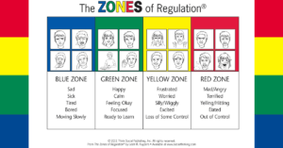
Using it with The Zones
NOTICE & CONNECT
Body signals Body signals to emotion
Notes:
Can enhance what we are already using.
Another piece of what we can provide for self-regulaton
Often missing in our strategies
Will strengthen what we are already doing
Our learners can memorise this – but unable to use aspcts of it in the moment b/c they lack IA. You need to be able to recognize how your body is feeling

Slide 19
Challenge our way of thinking
Traditional approaches – use external supports to modify behaviours to make the person act more ‘typical’ (e.g. behaviour charts, tokens)
Emerging approach – building internal supports that build skills and empower growth. We're helping them figure out what is best for then to be able to regulate.
Notes:
Also to think about EHCP outcomes

Slide 20
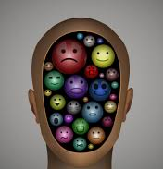
Interoception and emotions
“I have emotions – Sometimes I just need help to make sense of them!”
Notes:
We are NOT talking about people who lack emotions
Article written a few years ago how people with ASD lack emotions.
This is not true.
We are not talking about people that lack emotions – just unclear IA and need help making sense of them

Slide 21

Interoception and language development
Interoception gives emotion words meaning
Your body grounds these concepts

Slide 22
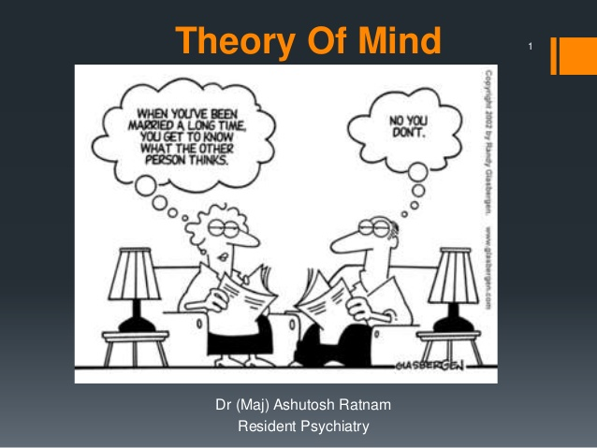
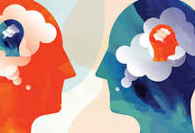
IA and Social participation
Perspective taking = the ability to understand another person’s emotions, thoughts, intentions, desires and ideas (also known as theory of mind)
The INSULA:
How Do I Feel”
And
How do you feel”
Notes:
Insula = interoeption part of brain
Research – hook up to brain and gave pain stimulus. When person felt pain, insula was activated
Then they hooked up the original person and brought in loved one – then gave loved one a pain stimulus –and watched what area of brain was activated – and saw that it was the insula. We don’t only use the insule/interoceptive input to figure out how WE are feeling – abut also how others are feeling.

Slide 23
Benefits of teaching interoception
Students connect to and learn their own bodies and emotions
Pre-requisite skill for self-management and self-regulation
Provide students with tools to know when they are developing emotional reactions and skills to be in control of those reactions
Without interoception, social skills are just the application of rules and not a meaningful way of interaction – enables students to develop a sense of belonging
Decreased behavioural challenges
Notes:
Classrooms where interocpetion is being taught – school wide behavior reporting analysis done.

Slide 24
How does the program work?
Body
Emotion
Action

Slide 25
Step 1 - BODY
Objectives
Noticing body signals
Increase ability to match descriptor words
Uses pattern of repeated instruction and practice to build solid habits and skills.
Lessons 1-16:
Go through different body parts and do ‘focus area experiments’
Start on outside body parts (hands/feet/mouth/eyes etc) = more concrete
Move to inside body parts (muscles/lungs/heart etc)

Slide 26
BODY
Step 1
Introduce body part of focus (e.g. hands)
Step 2
Create a descriptor menu
Step 3
Complete experiments
Step 4
Add body part icons to the Body Check Chart
Step 5
Practice using Body Check Chart
Notes:
During this part we help students to notice their body cues and add description words
We do this through a range of experiments or during incidental learning (e.g during catering or sensory circuits).
The therapy team would often introduce this during structured lessons by doing a range of ‘experiments’, but this is further embedded or expanced on throughout the school week e.g. during catering or sensory circuits.
We also use ‘body check charts’ which supports staff to do ‘body checks throughout the week’

Slide 27
Let’s practice
Experiments
Body check chart
Notes:
WE want to make sure students understand what it means/feels like
Once we have done this, we want to start pairing this with the emotion

Slide 28
STEP 2: EMOTION
Objectives
Increase the ability to give meaning to body signals noticed: To begin connecting body to emotion, forming solid body-emotion connections.
Both Affective and Homeostatic emotions are collectively referred to as ‘Emotions’

Slide 29
EMOTION
My body signals are clues to my emotions
Notes:
During these activities we want to support students to
Link their body cues to emotions.
Understand that each emotion have different body cues. WE might use activities such as guessing the emotion or linking body cues to a specific emotion (e.g. how will your body feel when you are sleepy.)
WE also wants students to start thinking what might be the cause of the emotion.
You said your bladder feels heavy. What could be making it feel that way?” (e.g., not peeing for a few hours). “If you haven’t peed in a few hours, what could your heavy bladder mean? What emotion?” “You said that your mouth feels dry. What could be the cause?“ (e.g., not drinking anything in a few hours). “What emotion do you feel?”
“You said your skin is sweaty and your heart is racing. What could be the cause?” (e.g., running on the playground). “What emotion are you feeling?”

Slide 30

Connecting body to emotion
Check my body
Check my emotion
Notes:
My body signals are clues to my emotions
Story and game cards:
Stuffy nose + nauseous stomach + burning eyes = sick
Dry mouth + dry throat = thirsty
Body experiment (e.g. hold eyes wide open for 15 s) How does it make your eyes feel? (Watery) What emotion can this be (tired/sad)
Rapid questions (How does it make your brain feel?) ‘Full’ What emotion could it be? (overwhelmed) When have you felt this way?
Body experiment (5 quick breathes in and out) How does it make your mouth feel? (Dry). What emotion? (thirsty)

Slide 31
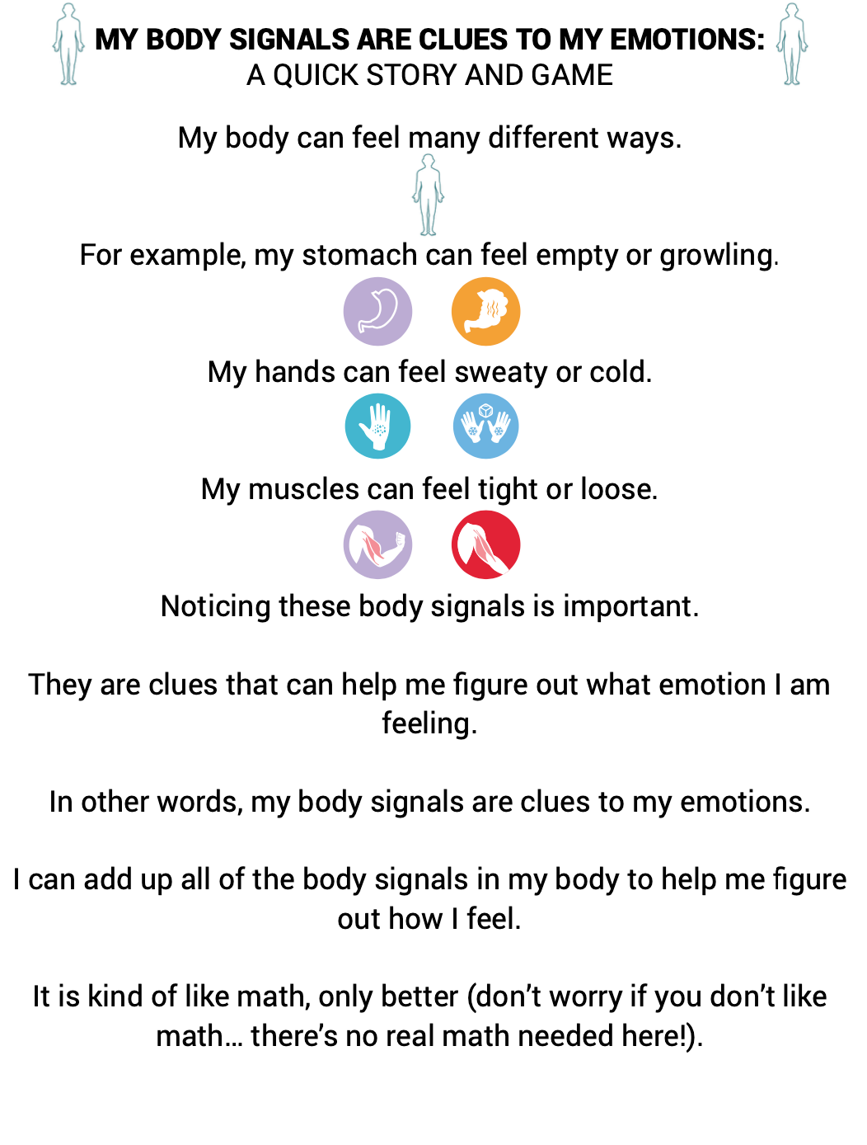

Slide 32
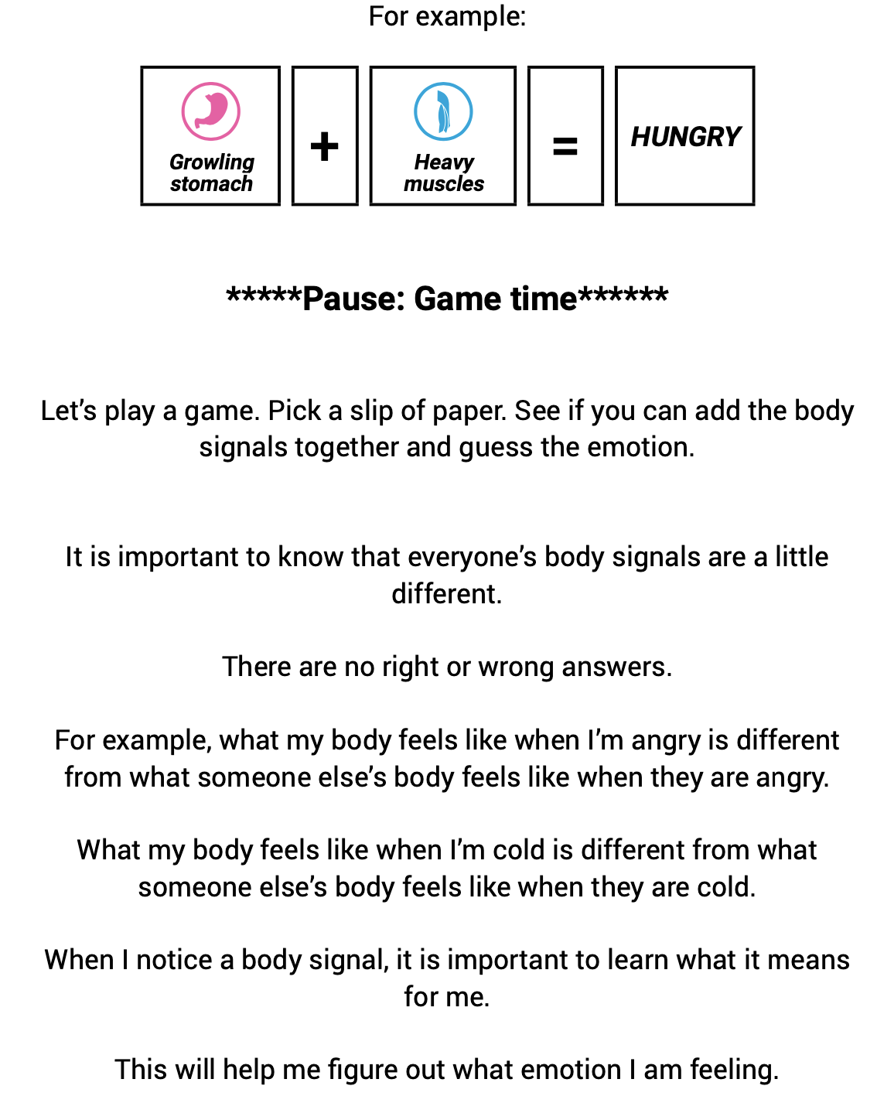
Notes:
Let’s try the game

Slide 33
EMOTION
Creating a body-emotion chart

Slide 34
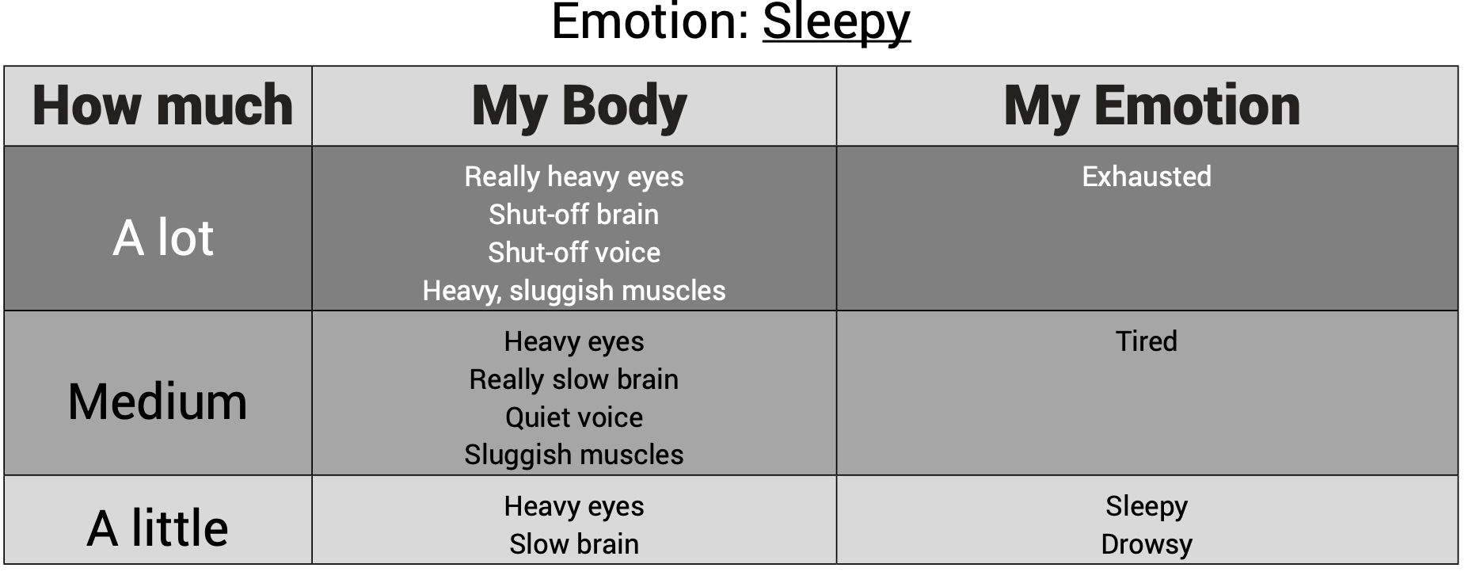

Slide 35
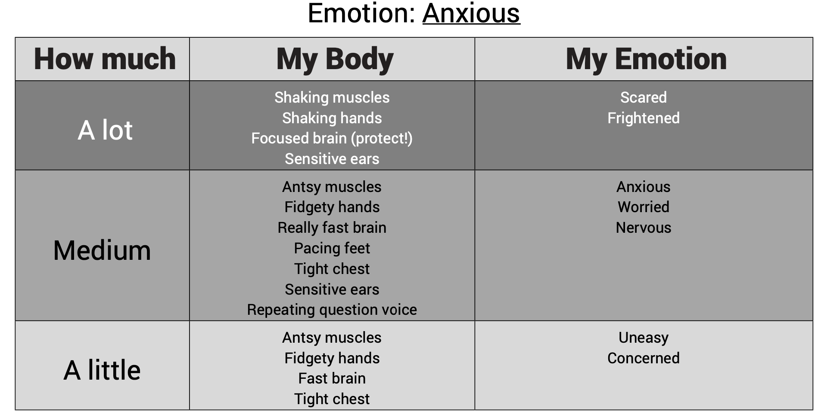

Slide 36
Step 3 = ACTION
Objectives
Increase the learner’s ability to use feel-good actions that can be used to promote comfortable body-emotion experiences

Slide 37
ACTION
Lesson 21: My body can feel comfortable, my body can feel uncomfortable
Lesson 22: I can change the way my body feels
Lesson 23: I can change the way my body feels when it is uncomfortable
Lesson 24: Discovering new feel-good actions
Lesson 25: Making my own feel-good menu
Notes:
Comfortable vs uncomfortable. Want to introduce this concept to students. We will speak about our bodies feeling comfortable/vs uncomfortable. Remember all body signals are important – there are no ‘wrong’ or ‘bad ‘ body signals. Uncomfortable body signals are nelpful as they give us nb info about what we need to do to take care of our bodies.
(e.g. last night reading book on couch – muscles calm and relaxed. I felt okay. Or Ate too late – hungry and nauseious – felt uncomfortable)
Change way body feels – e.g. when hungry and eat. During this part we will do some experiments e.g. drink ice cold water – do body check before and after and point how you could change how your body feels.
“You said your muscles feel loose and that your emotion is relaxed. What can you do to change the way your muscles feel?”
“You said your skin is sweaty and your heart is racing. What can you do to change the way your body feels?”
“Can you do something that changes the way your body feels?”
“Can you pick one of the body signals you just mentioned and do something that changes it right now?”
(Please note: it is okay to guide the learner through this process at first. For example, you can provide a few ideas that the learner can choose from)
Changing when uncomfortable . We talk about ‘feel good actions’ Se eL23)
New feel good actions – will introduce students to new options (can include sensory options) – see L24

Slide 38
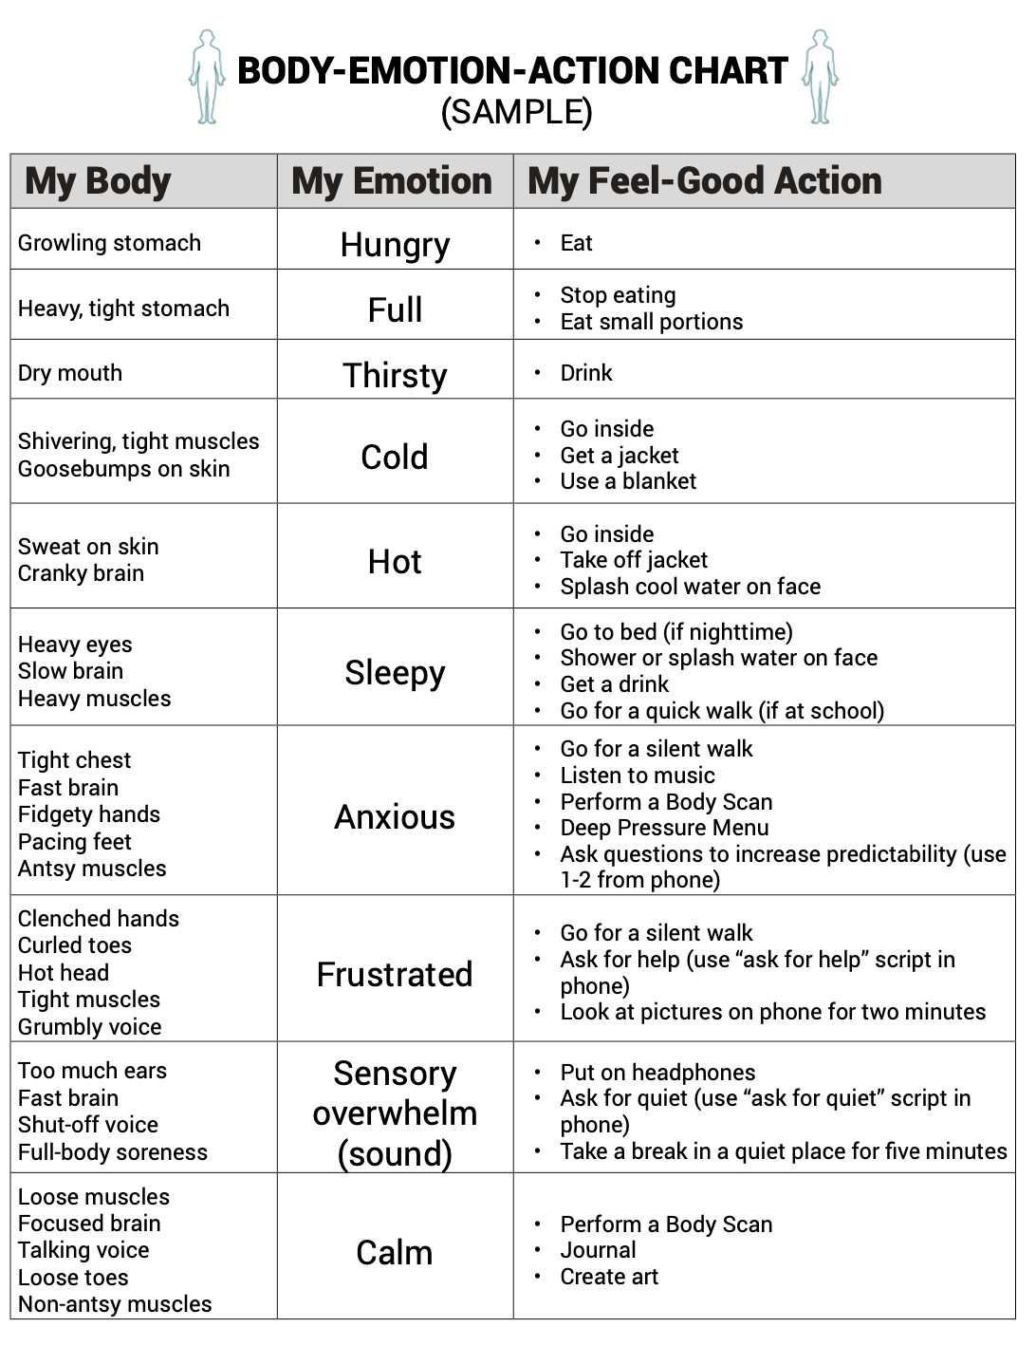
Notes:
Changing the way body feels and making a feel good action chart

Slide 39
ACTION
Discovering new feel good actions
Notes:
Links in really well with Zones and OT – sensory strategies (often where we have started!!)
KINDNESS MENU

Slide 40
How can you support?
Think about/model how your body feels
Comment on what you see
NO bad/negative body cues – all cues are valuable and can give us information.
Be curious – no right or wrongs. Ask
Support your child to do frequent body checks. When your child is in melt-down = not a good time to teach!
Work on your own interoception

Slide 41


